Slide 1


Foundations of
Scientific Computing
(SciComp 101)
Dave Biersach
dbiersach@bnl.gov
Session 05
Square Roots and Areas

Slide 2
Session 05 – Goals
Implement Newton's Method (discovered in 1669 AD) to numerically estimate the square root of a number
Compare Newton's Method to Heron's Method (invented in 50 AD) for finding square roots
Derive the quadratic formula using geometry and algebra
Estimate the area of a circle using rectangles
Calculate and display Euler’s Identity

Slide 3
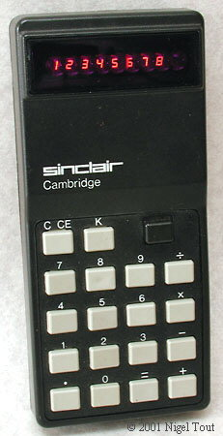
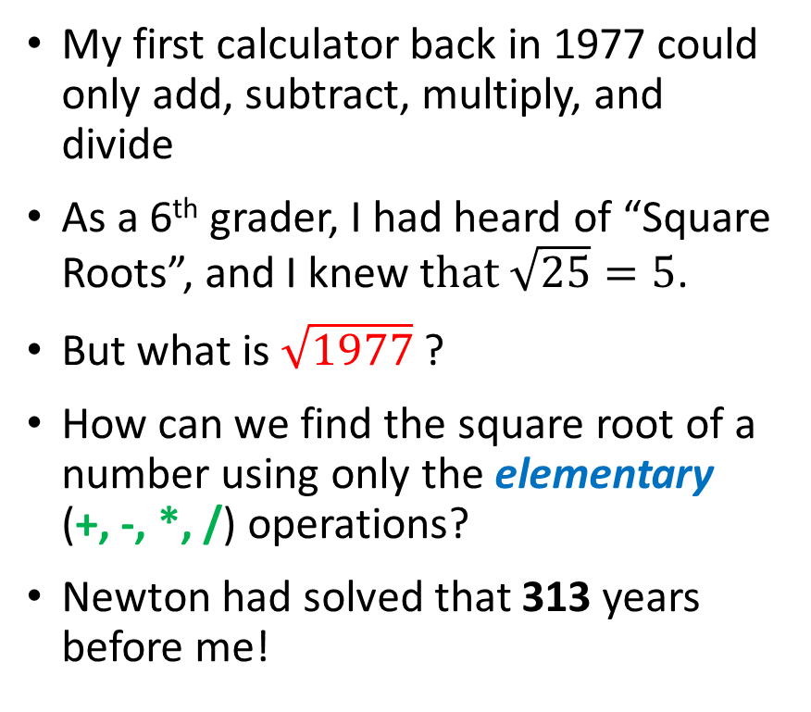
Old School Square Roots
My first calculator back in 1977 could only add, subtract, multiply, and divide
As a 6th grader, I had heard of “Square Roots”, and I knew t$hat \sqrt{25}=5$.
But what is $\sqrt{1977}$ ?
How can we find the square root of a number using only the elementary (+, -, *, /) operations?
Newton had solved that 313 years before me!

Slide 4
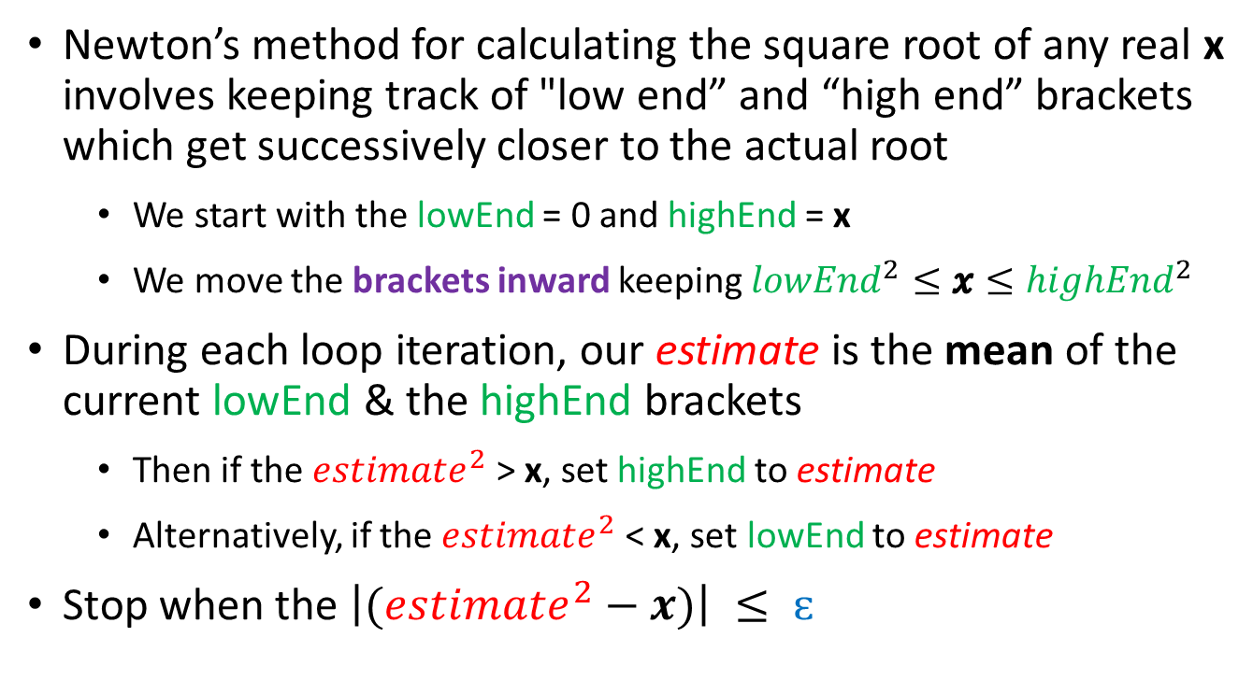
Old School Square Roots
Newton’s method for calculating the square root of any real x involves keeping track of "low end” and “high end” brackets which get successively closer to the actual root
We start with the lowEnd = 0 and highEnd = x
We move the brackets inward keeping ${lowEnd}^{2}≤x≤{highEnd}^{2}$
During each loop iteration, our estimate is the mean of the current lowEnd & the highEnd brackets
Then if the $estimate^{2}$ > x, set highEnd to estimate
Alternatively, if the $estimate^{2}$ < x, set lowEnd to estimate
Stop when the $\left|(estimate^{2}−x)\right| ≤ ɛ$

Slide 5
Newton’s Method for $\sqrt{49}$
$$ε=.0003$$
$$\frac{\left(lowEnd+highEnd\right)}{2}$$
highEnd moves down to the estimate
lowEnd
estimate
highEnd
0
24.5
49
$${24.5}^{2}=600.25$$
$$600.25>49$$
The estimate is too high!

Slide 6
Newton’s Method for $\sqrt{49}$
$$ε=.0003$$
$$\frac{\left(lowEnd+highEnd\right)}{2}$$
lowEnd
highEnd
0
12.25
24.5
49
$${12.25}^{2}=150.0625$$
$$150.0625>49$$
The estimate is too high!

Slide 7
Newton’s Method for $\sqrt{49}$
$$ε=.0003$$
$$\frac{\left(lowEnd+highEnd\right)}{2}$$
lowEnd
highEnd
0
6.125
12.25
49
$${6.125}^{2}=37.515$$
$$37.515<49$$
The estimate is too low!
lowEnd moves up to the estimate

Slide 8
Newton’s Method for $\sqrt{49}$
$$ε=.0003$$
$$\frac{\left(lowEnd+highEnd\right)}{2}$$
lowEnd
highEnd
highEnd moves down to the estimate
0
6.125
12.25
49
9.1875
$${9.1875}^{2}=84.410$$
$$84.410>49$$
The estimate is too high!

Slide 9
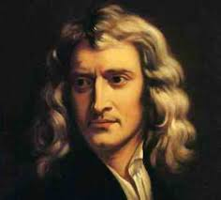
Newton’s Method for $\sqrt{49}$
$$ε=.0003$$
$$\frac{\left(lowEnd+highEnd\right)}{2}$$
lowEnd
highEnd
0
6.125
9.1875
49
7.65625
$${7.65625}^{2}=58.618$$
$$58.618>49$$
With each iteration we are closing in on the $\sqrt{49}=7$
The estimate is too high!
Isaac Newton (1642-1726)

Slide 10
Newton’s Method for $\sqrt{49}$
$$ε=.0003$$

Slide 11
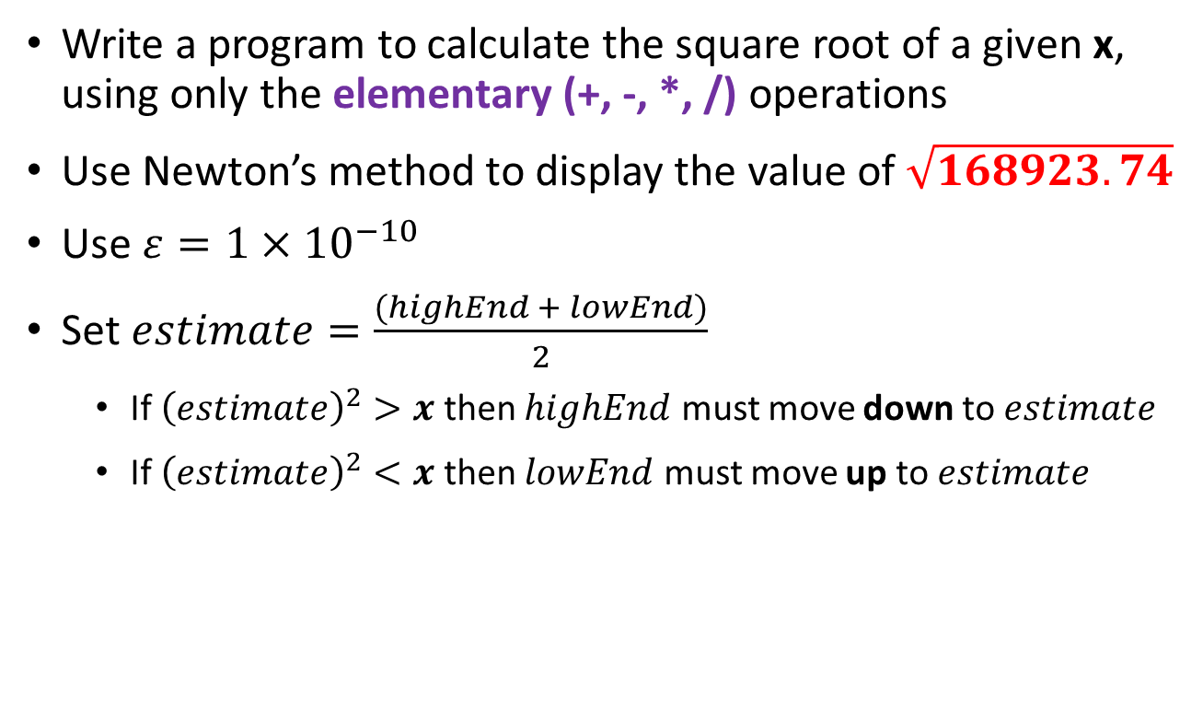
Newton’s Square Root
Write a program to calculate the square root of a given x, using only the elementary (+, -, *, /) operations
Use Newton’s method to display the value of $\sqrt{168923.74}$
Use $ε=1×{10}^{−10}$
Set $estimate=\frac{(highEnd + lowEnd)}{2}$
If ${\left(estimate\right)}^{2}>x$ then $highEnd$ must move down to $estimate$
If ${\left(estimate\right)}^{2}<x$ then $lowEnd$ must move up to $estimate$

Slide 12
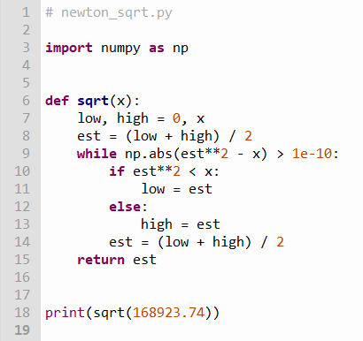
Edit newton_sqrt.py
②
③
④
⑤
9 lines of code
⑥
⑦
⑧
⑨
⑩
①

Slide 13

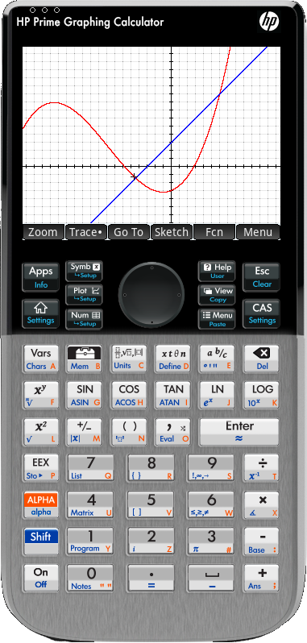
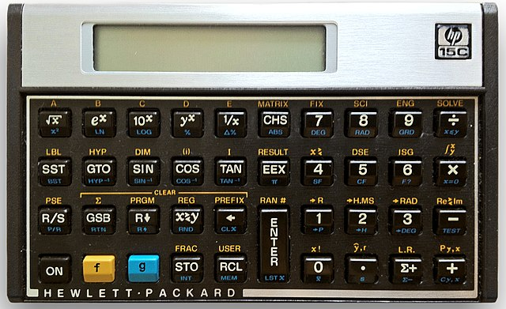


Run newton_sqrt.py
$$\sqrt{168923.74}=$$
$$ε=1×{10}^{−10}$$
My Kids
High School
Calculator
(2013)
My College Calculator (1985)

Slide 14
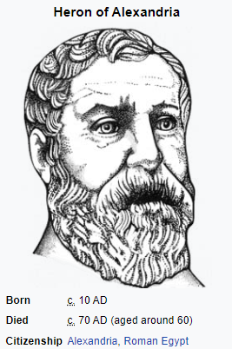
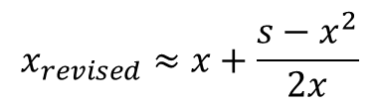


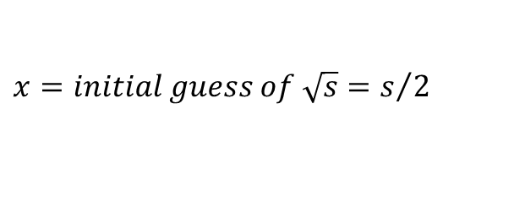

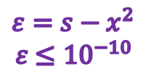
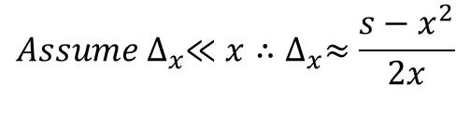

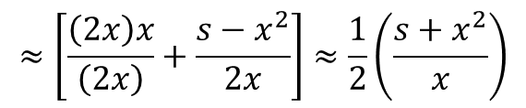
Heron's Method
$$x=initial guess of \sqrt{s}=s/2$$
$$s={(x+∆_{x})}^{2}=x^{2}+\left(2x\right)∆_{x}+∆_{x}^{2}$$
$$∆_{x}=\frac{s−x^{2}}{2x+∆_{x}}$$
$${Assume ∆}_{x}≪x∴∆_{x}≈\frac{s−x^{2}}{2x}$$
$$x_{revised}=x+∆_{x}$$
$$x_{revised}≈x+\frac{s−x^{2}}{2x}$$
$$≈\left[\frac{\left(2x\right)x}{\left(2x\right)}+\frac{s−x^{2}}{2x}\right]≈\frac{1}{2}\left(\frac{s+x^{2}}{x}\right)$$
$ε=s−x^{2}$ $ε$ $≤{10}^{−10}$
$$x_{revised}≈Mean\left(\frac{s}{x},x\right)$$

Slide 15
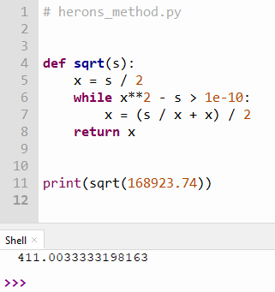
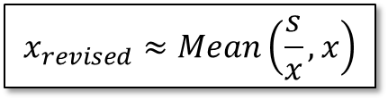
Open & Run herons_method.py
Note: You should not edit this file!
②
③
4 lines of code
④
⑤
⑥
$$x_{revised}≈Mean\left(\frac{s}{x},x\right)$$
①
⑦

Slide 16
Completing What Square?
$$ax^{2}+bx+c=0$$
$$ax^{2}+bx=−c$$
$$\frac{1}{a}\left(ax^{2}+bx\right)=\frac{1}{a}\left(−c\right)$$
$$x^{2}+\frac{b}{a}x=\frac{−c}{a}$$

Slide 17
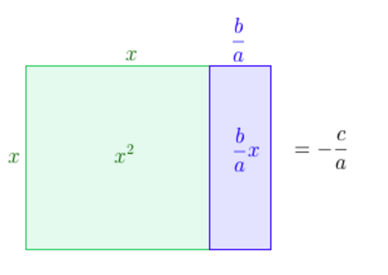
Completing What Square?
$$x^{2}+\frac{b}{a}x=\frac{−c}{a}$$

Slide 18
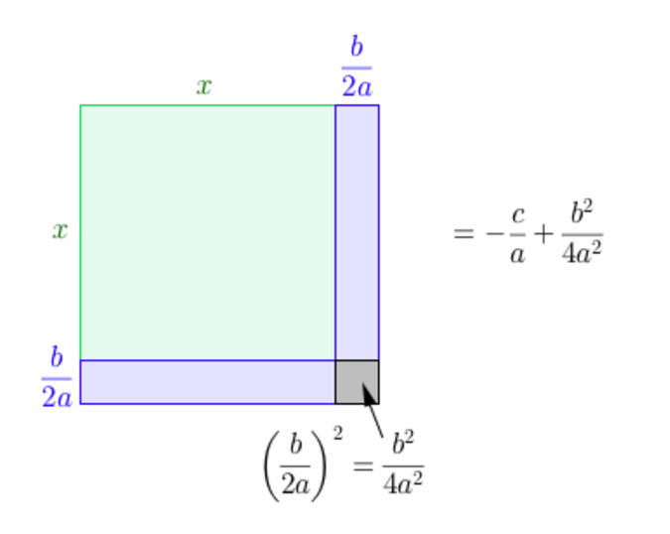
Completing What Square?
That square!

Slide 19
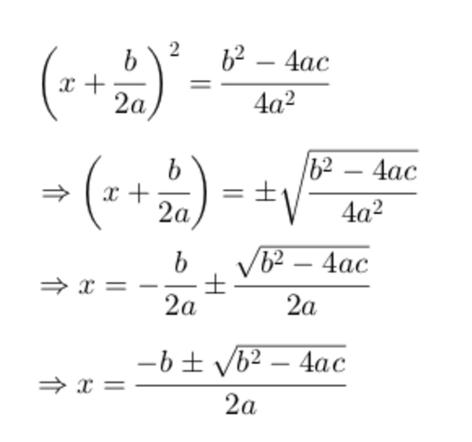
Completing What Square?

Slide 20
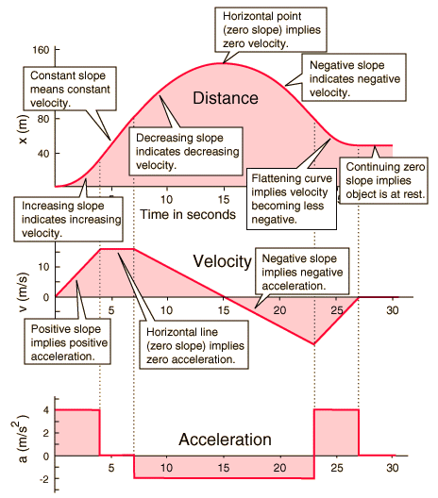
Why do we need integrals?

Slide 21
Why do we need integrals?

Slide 22
Why do we need integrals?
s
s
Differentiate
v
v
Integrate
a
a

Slide 23
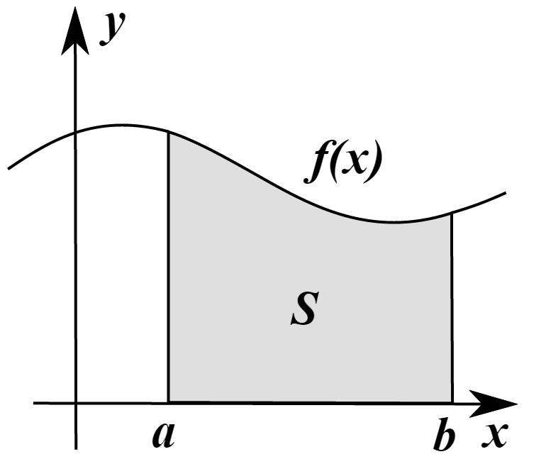
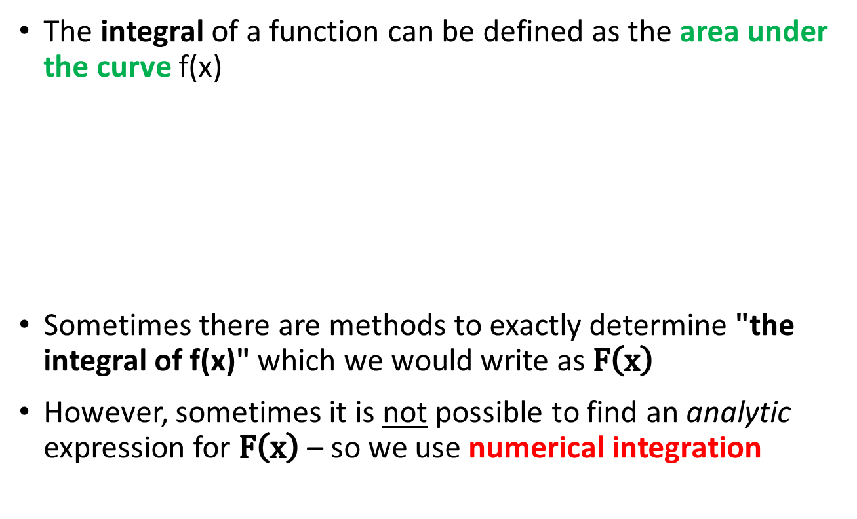
Why do we need integrals?
The integral of a function can be defined as the area under the curve f(x)
Sometimes there are methods to exactly determine "the integral of f(x)" which we would write as $F\left(x\right)$
However, sometimes it is not possible to find an analytic expression for $F\left(x\right)$ – so we use numerical integration

Slide 24
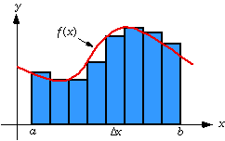
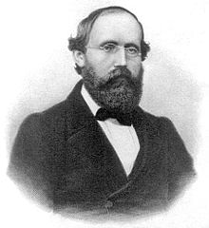
Riemann Sums
One way we can integrate f(x) is to divide the area under the curve into strips (intervals) and sum the area of each strip
This estimate may not be totally accurate because we might have gaps between the true value of f(x) and the top of a strip
Bernhard Riemann
1826 – 1863
(39 years old)

Slide 25
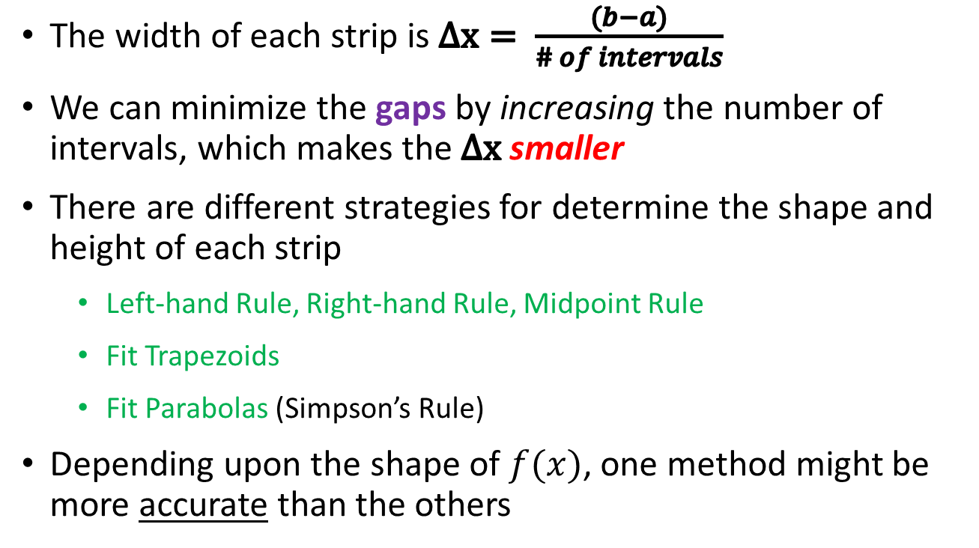
Riemann Sums
The width of each strip is $Δx= \frac{(b−a)}{\# of intervals}$
We can minimize the gaps by increasing the number of intervals, which makes the $Δx$ smaller
There are different strategies for determine the shape and height of each strip
Left-hand Rule, Right-hand Rule, Midpoint Rule
Fit Trapezoids
Fit Parabolas (Simpson’s Rule)
Depending upon the shape of $f(x)$, one method might be more accurate than the others

Slide 26
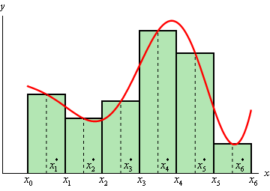
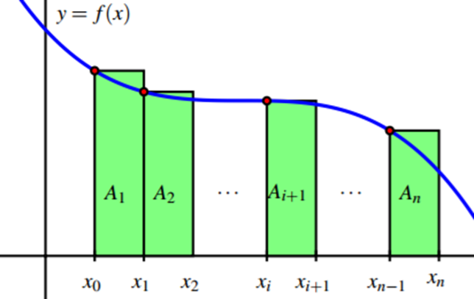
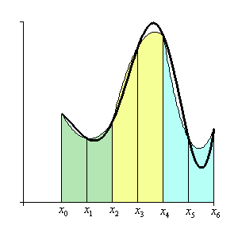
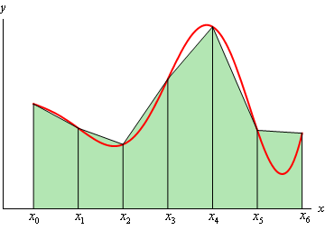
Riemann Sums
Left-Hand
Midpoint
Trapezoids
Parabolas
(Simpson’s Rule)

Slide 27
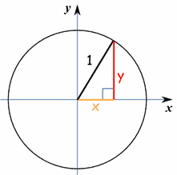
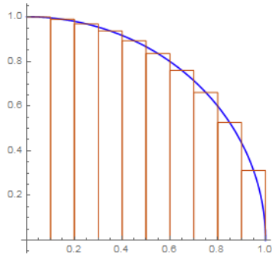
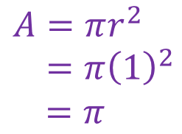




Area of a Unit Circle
Estimate the area of a unit circle centered at the origin
by summing the area of 1,000,000 contained rectangles
$$x^{2}+y^{2}=1$$
$$F\left(x\right)=4\int_{0}^{1}{\sqrt{1−x^{2}}ⅆx}$$
$$y=±\sqrt{1−x^{2}}$$
$$A=πr^{2}$$
$=π{\left(1\right)}^{2}$
$$=π$$
$$\frac{π}{4}$$

Slide 28
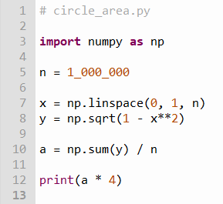
Edit circle_area.py
①
②
③
④
⑤

Slide 29

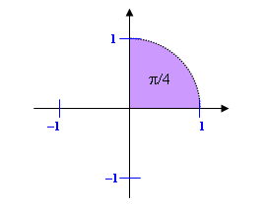


Run circle_area.py
$$π=\text{3.1415926535…}$$
$$A=πr^{2}$$
$=π{\left(1\right)}^{2}$
$$=π$$

Slide 30

The SciPy Package
https://scipy.org

Slide 31
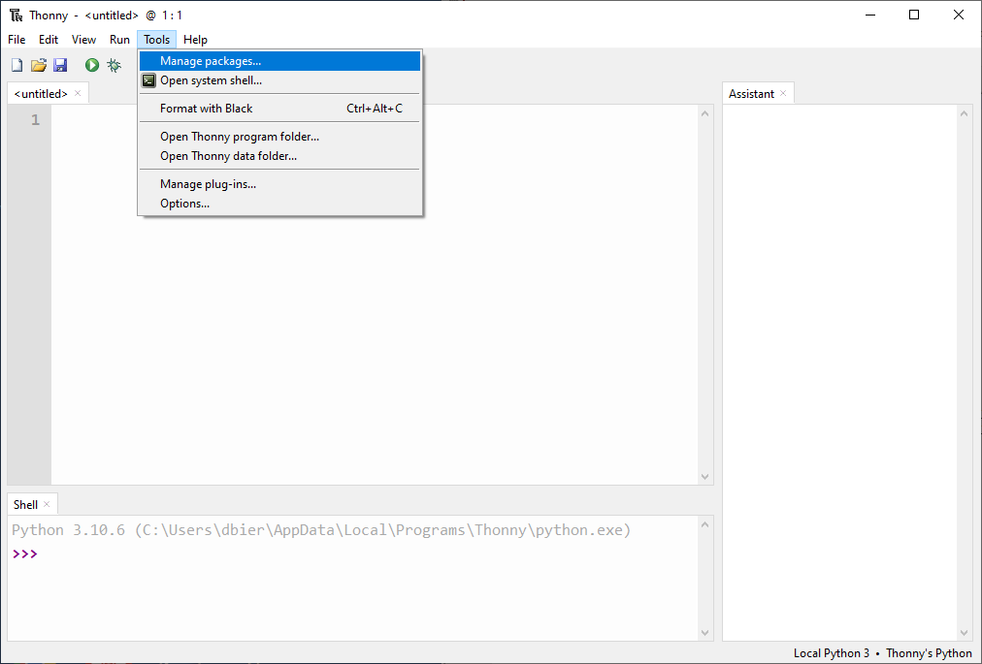
Installing the SciPy Package into Thonny

Slide 32
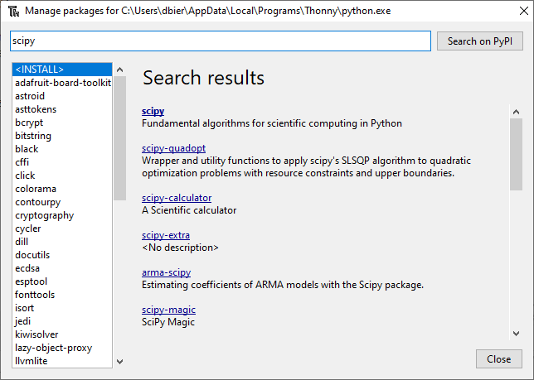
Search for the SciPy package

Slide 33
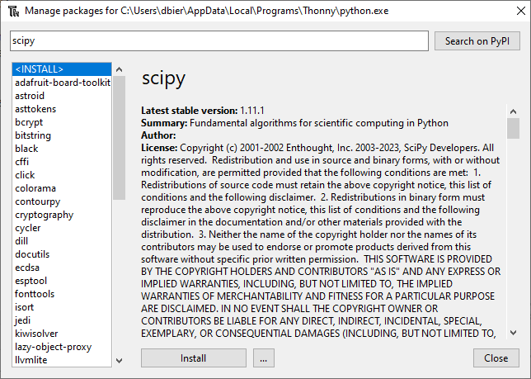
Install the SciPy Package

Slide 34
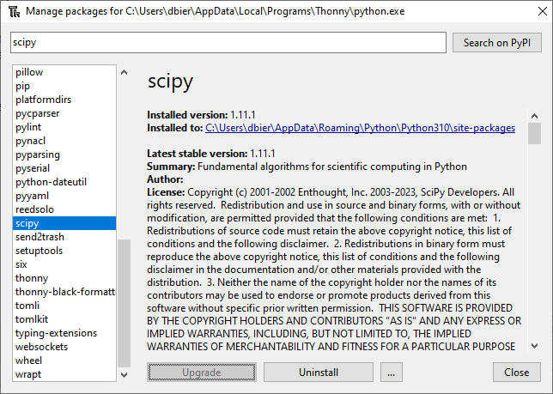
Verify the SciPy Package Installation

Slide 35
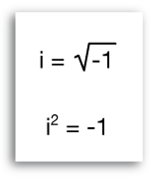
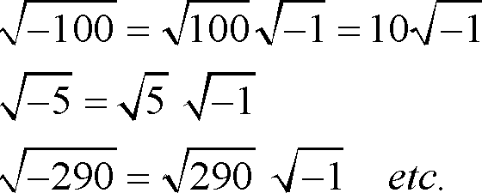
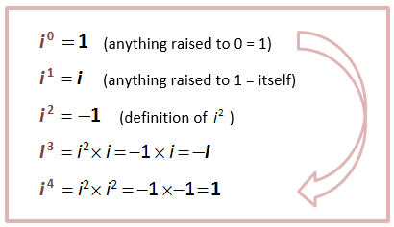
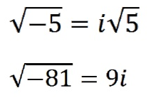
Complex Numbers

Slide 36
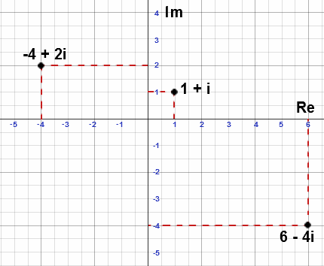
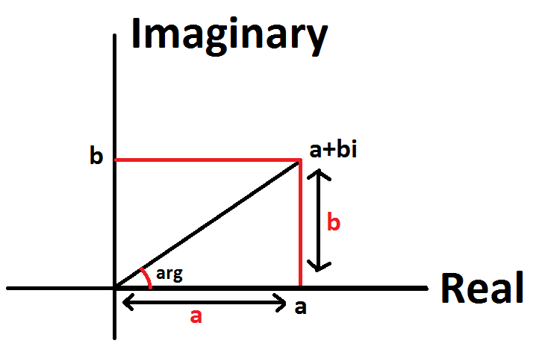
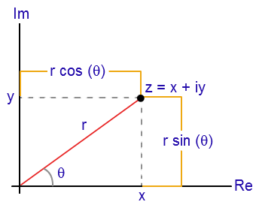
Complex Numbers
Argand
Diagram

Slide 37
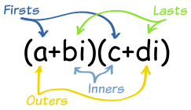

Complex Algebra
Sum:
$$\left(4+3i\right)+\left(5−4i\right)=\left(4+5\right)+\left(3−4\right)i$$
$$=9−i$$
Difference:
$$\left(4+3i\right)−\left(5−4i\right)=\left(4−5\right)+\left(3−\left(−4\right)\right)i$$
$$=−1+7i$$
Product:
$$\left(4+3i\right)\left(5−4i\right)=20−16i+15i−12i^{2}$$
$$=20−i+12$$
$$=32−i$$

Slide 38


Complex Algebra
Division:
$$\frac{\left(4+3i\right)}{\left(5−4i\right)}$$
$$\frac{\left(4+3i\right)}{\left(5−4i\right)}=\frac{\left(4+3i\right)}{\left(5−4i\right)}×\frac{\left(5+4i\right)}{\left(5+4i\right)}=\frac{\left(8+31i\right)}{41}$$
Complex Conjugate
$$=\frac{8}{41}+\frac{31}{41}i$$
Integer
Exponent:
$${(2−3i)}^{3}=\left(2−3i\right)\left(2−3i\right)\left(2−3i\right)$$
$$=−46−9i$$

Slide 39
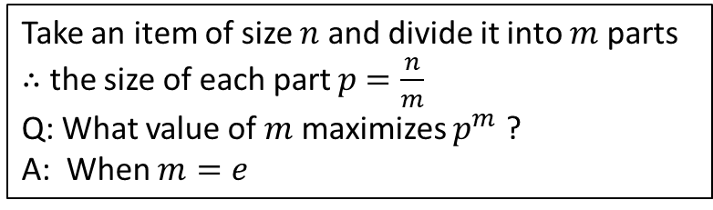

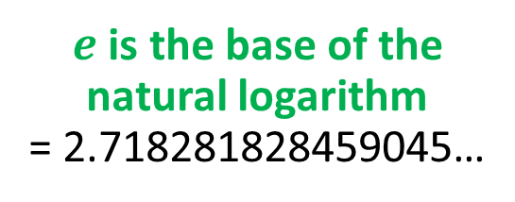
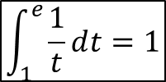



Why is $e$ so special?
Take an item of size $n$ and divide it into $m$ parts
$∴$ the size of each part $p$ $=\frac{n}{m}$
Q: What value of $m$ maximizes $p^{m}$ ?
A: When $m=e$
$$e=\sum_{n=0}^{∞}{\frac{1}{n!}=\frac{1}{1}+\frac{1}{1}+\frac{1}{2}+\frac{1}{6}+\frac{1}{24}+…}$$
$$e=\lim_{n→∞}{{\left(1+\frac{1}{n}\right)}^{n}}$$
$e$ is the base of the natural logarithm
= 2.718281828459045…
$$\int_{1}^{e}{\frac{1}{t}ⅆt=1}$$
$$\ln{e}=1$$

Slide 40
Why is $e$ so special?
$c≡$ a constant
$${ce}^{x}=c+cx+\frac{cx^{2}}{2!}+\frac{cx^{3}}{3!}+\frac{cx^{4}}{4!}+\frac{cx^{5}}{5!}+\frac{cx^{6}}{6!}+\frac{cx^{7}}{7!}+…$$
$\frac{d}{dx}\left(ce^{x}\right)=\frac{d}{dx}\left(c\right)+\frac{d}{dx}\left(cx\right)+\frac{d}{dx}\left(\frac{{cx}^{2}}{2!}\right)+\frac{d}{dx}\left(\frac{{cx}^{3}}{3!}\right)+…$
$$\frac{d}{dx}\left({ce}^{x}\right)=0+c+cx+\frac{cx^{2}}{2!}+\frac{x^{3}}{3!}+\frac{x^{4}}{4!}+\frac{x^{5}}{5!}+\frac{x^{6}}{6!}+\frac{x^{7}}{7!}+…$$
$$\frac{d}{dx}\left(ce^{x}\right)={ce}^{x}$$
${ce}^{x}$is the only function which is the derivative of itself !

Slide 41



Why is $e$ so special?
$c≡$ a constant
$$\frac{d}{dx}\left(ce^{x}\right)={ce}^{x}$$
${ce}^{x}$is the only function which is the derivative of itself !

Slide 42

Euler’s Identity
Calculate an approximation of $e^{z}$ where $z∈ℂ$, using its Taylor Series expansion to 20 terms
$$e^{z}=1+z+\frac{z^{2}}{2!}+\frac{z^{3}}{3!}+\frac{z^{4}}{4!}+\frac{z^{5}}{5!}+\frac{z^{6}}{6!}+\frac{z^{7}}{7!}+…$$
Use the above power series to display the value of $e^{πi}$
$$(e^{z} where z=0+πi)$$
Notice the denominators grow at a factorial rate
Fortunately, in Python the size of an integer is not restricted to a fixed number of number of bits
In Python an int can expand in size to the limit of the available memory!

Slide 43





Edit euler_identity.py
$$x=0→19$$
$$z=0+πi$$
①
②
$$e^{z}=\sum_{x=0}^{∞}{\frac{z^{x}}{x!}}$$
③
④
⑤
⑥
$$0!=1$$

Slide 44





Run euler_identity.py
$$e^{πi}=\sum_{x=0}^{∞}{\frac{{\left(πi\right)}^{x}}{x!}}=$$
$$e^{πi}=−1$$
$$e^{πi}+1=0$$

Slide 45


Euler’s Identity
$$e^{πi}+1=0$$

Slide 46
$$−1=e^{πi}$$
$$i^{i}= ?$$
$${\left(−1\right)}^{\frac{1}{2}}={\left(e^{πi}\right)}^{\frac{1}{2}}$$
$$\sqrt{−1}=e^{\frac{πi}{2}}$$
$${\left(a^{b}\right)}^{c}=a^{bc}$$
$${\left(2^{3}\right)}^{4}=2^{3×4}=2^{12}$$
$$i=e^{\frac{πi}{2}}$$
$$i^{i}={\left(e^{\frac{πi}{2}}\right)}^{i}$$
$$e^{πi}=−1$$
$$i^{i}=e^{\frac{πi^{2}}{2}}$$
$$i^{i}=e^{\frac{−π}{2}}$$
$i^{i}≅0.20787∈ℝ$

Slide 47
Session 05 – Know You Know…
Newton's Method is based on iteration: we continue to slide the low and high estimate of the square root closer to the "middle" (the correct answer) after each iteration
Heron's Method requires fewer lines of code and converges faster (fewer iterations) than Newton's Method – but Newton's Method can be easily modified to find cube roots, fourth roots, etc.
We can find the integral of a function (the area under its curve) by summing the area of a series of small rectangles
Euler's Identity unites the five fundamental constants in Math and is nothing more than the sum of raising a specific complex number to a series of integer exponents and then dividing by growing factorials

Slide 48

Task 05
Update the code in logarithm_series.py to calculate this sum:
$$s=\sum_{k=1}^{30}{\frac{1}{2^{k}k}}$$
Then calculate and print this value: $e^{s}$

